Slide 1

Final
Summary
of C GUI Calculator
Calculating various term
Presentation
📍 North South University
📞 +8801970980064

Slide 2
CSE115 Section 4 | Project Group 9
C GUI Calculator
A Scientific Calculator Using C and GTK+ 3
Md. Rafi Sarkar
2522795642
Ainul Huque
2521763642
Md. Hasibul Halim
2524375642
Md. Ahasanul Hasan Kabir
2524716642
Md. Rahat Sarkar
2413522642

Slide 3




C GUI Calculator Summary
Executive Summary
Purpose: Create a user-friendly calculator with a clean Graphical User Interface (GUI)
Features:
Basic arithmetic operations
Scientific functions (trigonometric, etc.)
Goal: Accuracy, simplicity, and efficiency for all users
Learning Outcomes: GUI design, event handling, input validation

Slide 4
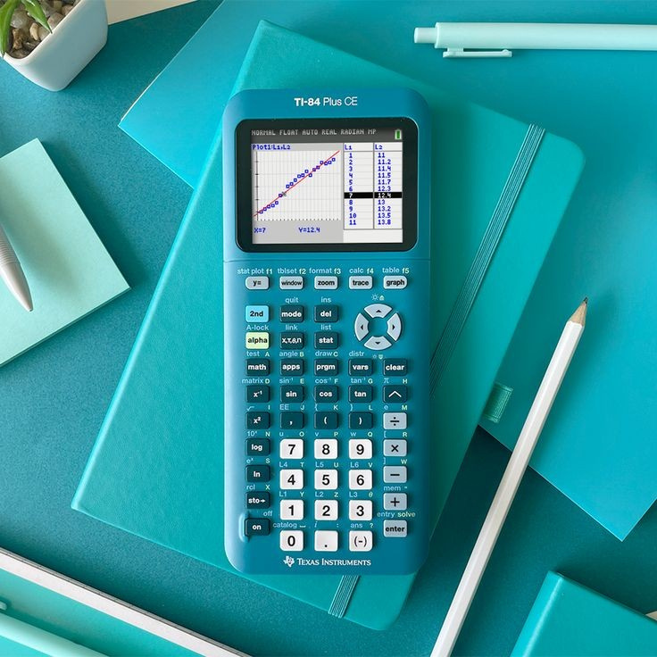
C GUI Calculator Summary
PROJECT OVERVIEW
🧮 What We Built
A complete scientific calculator application with graphical interface
💻 Technology Stack
C Programming Language + GTK 3 GUI Framework
🎯 Purpose
Learn GUI programming, algorithms, and team collaboration
Our calculator performs both basic arithmetic and advanced scientific functions with intelligent error handling

Slide 5
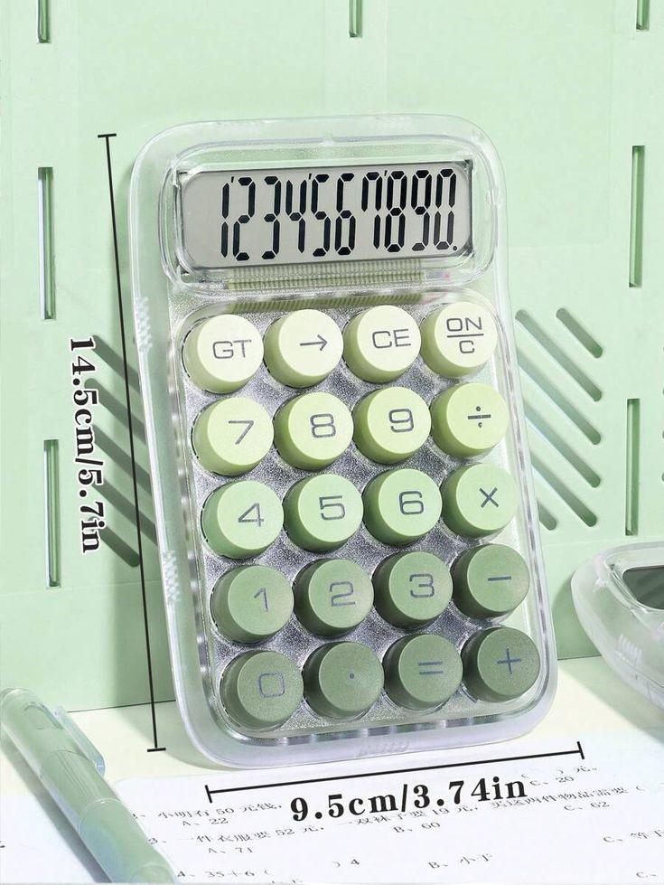
C GUI Calculator Summary
KEY
FEATURES
➕ Basic Operations
📊 Scientific Functions
Addition, Subtraction
Multiplication, Division
Exponentiation (^)
Trigonometry (sin, cos, tan)
Square root, Logarithms
Natural logarithm
🧠 Smart Features
🖱️ User Interface
Complex expressions
Parentheses support
Error handling
Intuitive button layout
Keyboard shortcuts
Clear error messages

Slide 6


C GUI Calculator Summary
PROGRAM
ARCHITECTURE
🧠 Math Brain
📺 Calculator Display
Parses and evaluates mathematical expressions using the Shunting Yard algorithm
GTK+ entry widget showing current input and results with right-aligned text
🔘 Button Handler
🗄️ Memory Manager
Processes all button clicks and keyboard input with smart auto-clear behavior
Dynamic stacks and proper memory cleanup to prevent crashes and leaks

Slide 7
Why It Matters
C GUI Calculator Summary
The Shunting Yard Algorithm
Input: 2 + 3 * 4
Computer sees: Which operation first?
Algorithm converts to: 2 3 4 * +
Result: 14 (not 20!)
Real Example
Handles operator precedence
Manages parentheses correctly
Processes functions properly
Enables complex expressions
sin(30) + cos(60) * 2 ↓ Converts to ↓ 30 sin 60 cos 2 * + = 1.5

Slide 8

Smart Data Structures
🏗️ Token System
📚 Dynamic Stacks
Breaks "sin(30)+2" into:
sin | ( | 30 | ) | + | 2
Automatically resize as needed:
• Number stack for calculations
• Token stack for parsing
💾 Calculator State
🔍 Lexical Analyzer
Remembers:
• Current input
• Last error message
• UI state flags
Identifies:
• Numbers (including decimals)
• Operators and functions
• Parentheses and special chars

Slide 9


Robust Error Handling
Common Errors We Catch
Smart Solutions
5 ÷ 0 → "Division by zero"
√(-4) → "Cannot take square root of negative"
tan(90°) → "Tangent undefined at 90°"
log(0) → "Logarithm undefined for zero"
((2+3) → "Mismatched parentheses"
Domain checking before calculations
Clear error messages for users
Graceful recovery without crashes
Input validation at every step
Memory safety with proper cleanup
Our calculator never crashes – it always provides helpful feedback

Slide 10
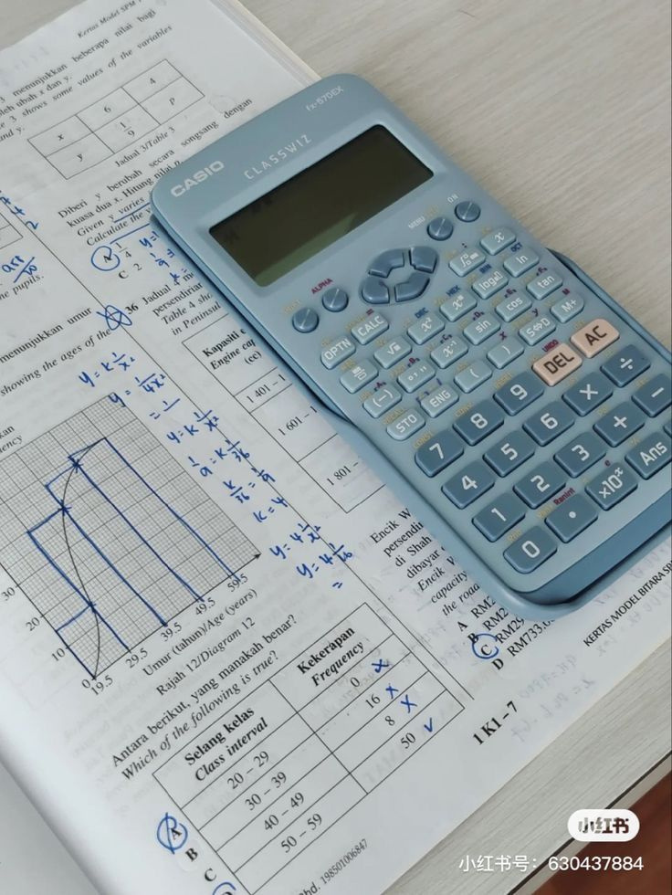
Calculator
In Action
C GUI Calculator Summary
📊 Basic Math
🧮 Complex Expressions
5 + 3 = 8
10 - 4 = 6
7 * 8 = 56
15 / 3 = 5
2^4 = 16
(5 + 3) * 2 = 16
10 + 2 * 3 = 16
2^3^2 = 512
sin(30) + cos(60) = 1
sqrt(9) + log(10) = 5
🔬 Scientific Functions
sqrt(16) = 4
sin(30) = 0.5
cos(60) = 0.5
log(100) = 2
ln(2.718) ≈ 1

Slide 11
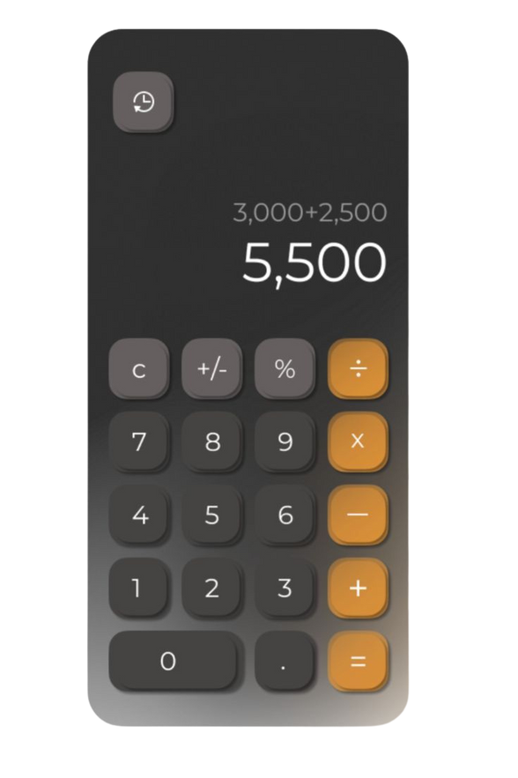
C GUI Calculator Summary
User Experience Design
🎨 Clean Interface
⌨️ Keyboard Support
Familiar calculator layout
Large, readable display
Consistent button sizes
Professional styling
Enter key for calculations
Backspace for corrections
Number keys work directly
Operator keys supported
🧠 Smart Behavior
🌐 Cross-Platform
Auto-clear after results
Continue calculations with operators
Right-aligned text display
Error state handling
Works on Windows
Runs on macOS
Compatible with Linux
GTK+ 3 portability

Slide 12
Challenges We Overcame
C GUI Calculator Summary
🚧 Technical Challenges
👥 Team Challenges
Expression Parsing
Problem: Understanding "2+3*4" = 14
Solution: Implemented Shunting Yard algorithm
Memory Management
Problem: Preventing crashes and leaks
Solution: Dynamic arrays with proper cleanup
GUI Design
Problem: Making it look professional
Solution: Studied GTK+ documentation thoroughly
Code Coordination
Problem: 5 people, one codebase
Solution: Git version control workflow
Task Division
Problem: Splitting work effectively
Solution: Modular architecture design
Testing & Debugging
Problem: Finding edge cases
Solution: Systematic testing approach

Slide 13


C GUI Calculator Summary
Project Success!
What We Accomplished
Built a fully functional scientific calculator
Implemented complex algorithms from scratch
Created an intuitive user interface
Achieved robust error handling
Developed cross-platform compatibility
Personal Growth
This project bridged the gap between theoretical computer science and practical application development. We're proud of creating a tool that's both functional and educational!

Slide 14

C GUI Calculator Summary
THANK YOU!
Scan the QR code if your are interested.

